Slide 1
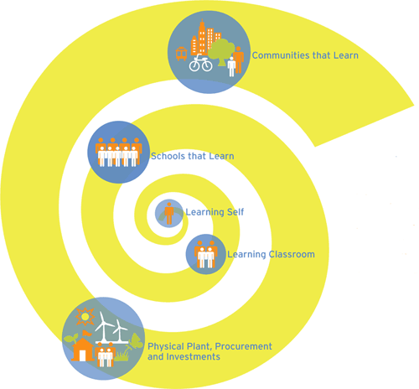
Education for Sustainability (EfS) and Cultural Competency (CC): Where are the Connections?

Slide 2
The Most Important Convergence A Work in Progress…
.” -Cloud

Slide 3
The Most Important Convergence A Work in Progress…
“The inclusion of diversity is required in order for us to thrive.” -Jones
“Diversity makes our lives possible.” -Cloud
“The inclusion of diversity is required in order for us to thrive and is a form of Biomimicry (mimics nature).” –Jones/Cloud
“Leveraging diversity through inclusion makes our lives possible.” –Jones/Cloud

Slide 4
The Most Important Convergence A Work in Progress…
“The inclusion of diversity is required in order for us to thrive.” -Jones
“Diversity makes our lives possible.” -Cloud
“The inclusion of diversity is required in order for us to thrive and is a form of Biomimicry (mimics nature).” –Jones/Cloud
“Leveraging diversity through inclusion makes our lives possible.” –Jones/Cloud

Slide 5
The Most Important Convergence A Work in Progress…
“The inclusion of diversity is required in order for us to thrive.” -Jones
“Diversity makes our lives possible.” -Cloud
“The inclusion of diversity is required in order for us to thrive and is a form of Biomimicry (mimics nature).” –Jones/Cloud
“Leveraging diversity through inclusion makes our lives possible.” –Jones/Cloud

Slide 6
The Most Important Convergence A Work in Progress…
“The inclusion of diversity is required in order for us to thrive.” -Jones
“Diversity makes our lives possible.” -Cloud
“The inclusion of diversity is required in order for us to thrive and is a form of Biomimicry (mimics nature).” –Jones/Cloud
“Leveraging diversity through inclusion makes our lives possible.” –Jones/Cloud

Slide 7
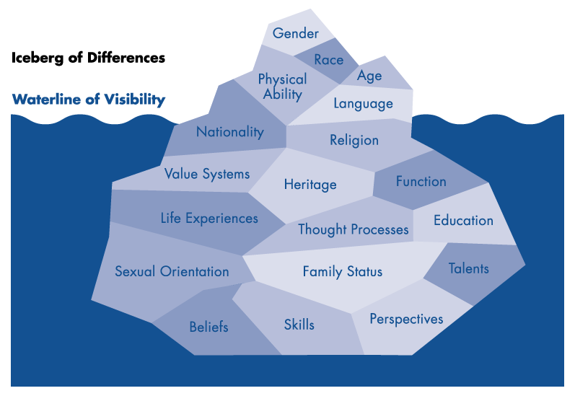
Shared Metaphor: the Iceberg

Slide 8
“Everything is internally consistent
within the frame we are operating.”
-Senge/EfS
“Most people make sense to themselves.”
-Jones/CC

Slide 9
“It all begins with a change in thinking.”
-Cloud/Jones/EfS/CC

Slide 10
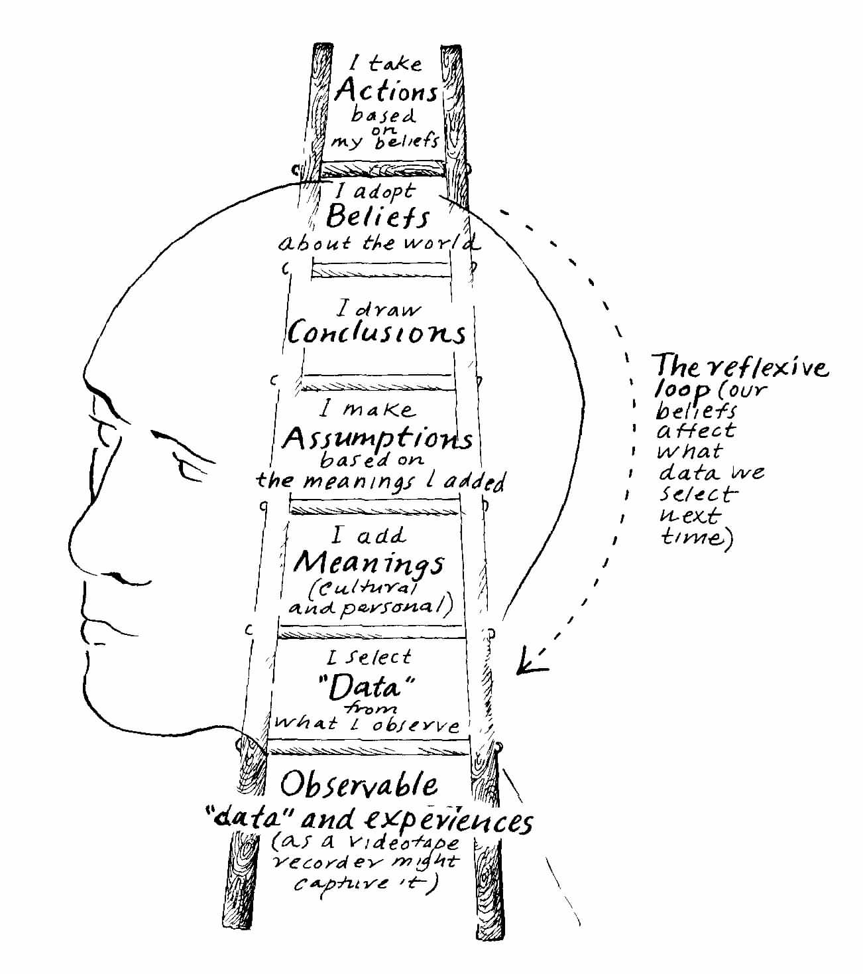
Shared Metaphor: the Ladder of Inference
Reference: Massey Network Learning Communities

Slide 11
The Four Elements of Cultural Competence
Multiple Perspectives
Cross-Cultural Effectiveness Skills
Cultural
Self-Awareness
Cultural Intelligence
Countering Oppression through Inclusion
The Dynamics of Systems and Change
Cultural Preservation and Transformation
© 2010 Jones & Associates Consulting, Inc.
Responsible Local and Global Citizenship

Slide 12
Standard: A. Cultural Preservation and Transformation
Consider the benefits of cultural homogeneity and of cultural diversity to the sustainability of a community in a place over time.
Use stories and the arts to document and make visible what should be preserved and what needs to change in order to contribute to the sustainability of our communities in our places over time.

Slide 13
Standard: B. Responsible Local/Global Citizenship
Form an opinion about the requirements of responsible local, national, and global citizenship by synthesizing diverse perspectives on participation and governance.
Demonstrate individual and collective respect for themselves and the Commons.

Slide 14
Standard: C. The Dynamics of Systems & Change
See the whole system, its parts, and their place within the system.
Define what a system is and determine if things are or are not systems.

Slide 15
Standard: D. Sustainable Economics
Illustrate their understanding of the relationships among ecological, economic and social systems.
Calculate the buying power of their generation per year and take responsibility for contributing to a sustainable future by changing their consumption patterns.

Slide 16
Standard: E. Healthy Commons
Develop criteria to reconcile the conflicts that exist between our individual rights and our responsibilities as citizens to tend the Commons, in relation to specific Commons.

Slide 17
Standard: F. Natural Laws and Ecological Principles
Demonstrate awareness of the importance of a great diversity of life (biodiversity) to the long-term sustainability of humankind and other living species on Earth.

Slide 18
Standard: G. Inventing and Affecting the Future
Develop visioning skills to create a healthy and sustainable future.
Distinguish goals from indicators (problems from symptoms).
Identify the most upstream problems to address within their sphere of influence.

Slide 19
Standard: H. Multiple Perspectives
Seek to determine the interests that underlie people’s positions and behaviors.
Identify Author’s Purpose. Reading Standard
Distinguish Positions from Interests (Win Win Negotiation: Getting to Yes, Fisher and Ury, Harvard School of Negotiation)

Slide 20
Standard: I. A Sense of Place
Create a celebration of the unique cultural character of a place.
Engage in goal setting/future visioning.

Slide 21
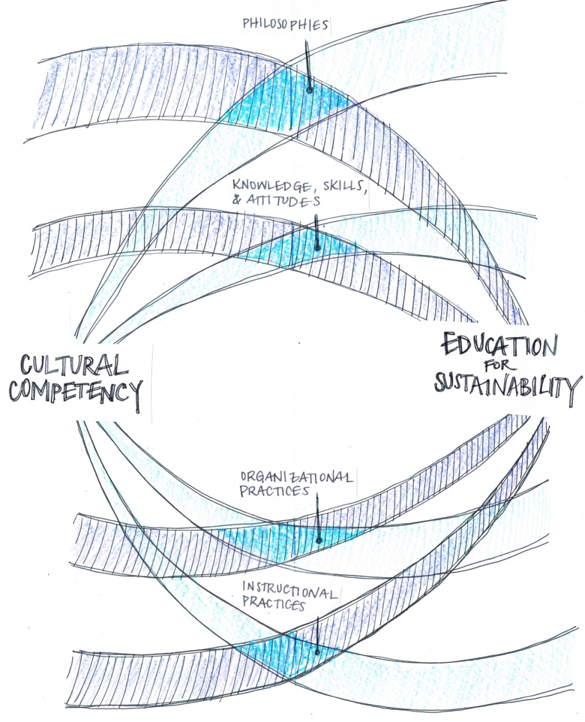

Slide 22
Curriculum Applications
Choose one performance indicator in blue italics
Select a lesson in a unit you have documented and mapped
Embed the performance indicator into the lesson
Innovate the lesson accordingly
Does it change your essential question? The guiding questions?
Does it change the activities? Does it change the assessment?
Does it change the performance criteria?
Does it change the student work product/performance that you assign to your students that will provide evidence of this attribute?
What changes would you expect to see in student work as a result of embedding this new performance indicator into your lesson?

Slide 23
EfS & CC: Shared Philosophies
All students can learn and meet high standards.
All students have the right to be honored as individuals.
Diversity makes our lives possible and contributes to resilience (at all levels).
Reflective practices improve education
1 of 2

Slide 24
EfS & CC: Shared Philosophies
Understanding EfS and Cultural Competency can strengthen educational curriculum and practices.
EfS and Cultural Competency standards can act as a hub for building collective capacities and strategic vision amongst all stake holders in the service of the future we want.
2 of 2

Slide 25
EfS & CC: Shared Instructional Practices
Educators use standards and assessment-driven curricula and instruction to provide the support and the challenges necessary for individual students to recognize and achieve their educational potential.
Educators continually read the feedback (assess and analyze) to improve practices over time.
1 of 4

Slide 26
EfS & CC: Shared Instructional Practices
Educators use backwards design to create and implement interdisciplinary curricula that integrates principles of EfS and cultural competency.
Educators incorporate place-based methodologies to incorporate local ways of knowing and an understanding of historical and cultural knowledge relevant to their work.
2 of 4

Slide 27
EfS & CC: Shared Instructional Practices
Educators use constructivist approaches to teaching, authentic instruction and assessment, learner-centered instruction, cooperative learning and differentiation to encourage student engagement, honor different learning styles, and provide multiple opportunities for students to share what they know.
3 of 4

Slide 28
EfS & CC: Shared Instructional Practices
Educators use their understanding of EfS and Cultural Competency to create more opportunities for diverse and authentic student engagement.
Educators use curriculum design and instructional methodologies to produce authentic and engaged learning.
4 of 4

Slide 29
EfS & CC: Shared Organizational Practices
Educators conduct a strengths assessment and review gaps in curriculum and programming to inform the practices of the school and teachers.
Educators fully integrate EfS and CC into the scope and sequence of the school’s curriculum.

Slide 30
EfS and CC Share the Following Attributes:
Learning to action: emphasis on applied learning
We can learn, and we can change things in the service of the future we want
Focus on self assessment, continuous improvement, life-long learning, growth, and the growth mindset
Reflective thinking and practice

Slide 31
EfS and CC Share the Following Attributes:
Learning to action: emphasis on applied learning
Meta-cognitive skill development: thinking about our thinking
Thinking drives behavior and behavior causes results
Read the feedback
We are all responsible for the difference we make
Recognition that a system’s structure generates its behavior

Slide 32
EfS and CC Share the Following Attributes:
Learning to action: emphasis on applied learning
Richness is in the dynamics of the relationships between the parts
The importance of surfacing and testing assumptions and mental models, biases, beliefs, and privileges
The power of visioning and creativity in inventing the future we want
CELEBRATION!

Slide 33
A Collaboration Between
Jones and Associates Consulting, Inc. www.jandaconsult.com
Marin Country Day School
www.mcds.org
The Cloud Institute
for Sustainability Education
www.cloudinstitute.org

